Slide 1
Christianity
HSC REVISION

Slide 2
SYLLABUS
Significant Person or Practice (Pope John XXIII)
Contributions to the development and expression of Islam
Impact on Islam
Ethics (Sexual Ethics)
Core ethical teachings
Significant Practice (Marriage Ceremony)
Describe the practice
Principal beliefs expressed through the practice
Significance of the practice to individuals and the Christian community

Slide 3
Pope John XXIII: Contributions
His Writings (show context. When were they written? What are they about? What was happening in his life at the time?)
Encyclicals:
Pacem In Terris (Peace on Earth)
Mater et Magistra (Teacher and Mother)
Vatican II Documents
His position and influence as Pope, leader of the Roman Catholic Church

Slide 4
Pope John XXIII’s Contributions:
Contribution of John XXIII to development of Christianity
His pontificate, which lasted less than five years, presented him to the entire world as an authentic image of the Good Shepherd. Meek and gentle, enterprising and courageous, simple and active, he carried out the Christian duties of the corporal and spiritual works of mercy: visiting the imprisoned and the sick, welcoming those of every nation and faith, bestowing on all his exquisite fatherly care. His social magisterium in the Encyclicals Pacem in terris and Mater et Magistra was deeply appreciated.
The faithful saw in him a reflection of the goodness of God and called him "the good Pope". He was sustained by a profound spirit of prayer. He launched an extensive renewal of the Church, while radiating the peace of one who always trusted in the Lord.
He convoked the Roman Synod, established the Commission for the Revision of the Code of Canon Law and summoned the Second Vatican Council.
He is also honoured by many Protestant organizations as a Christian reformer. Both Anglican and Lutheran denominations commemorate John XXIII as a "renewer of the church."

Slide 5
Pope John XXIII’s Contributions:
ECUMENISM
The late Pope John XXIII, more than anyone else, made a profound contribution to the ecumenical climate of his day.
Today a new climate of cooperation exists between Roman Catholics and Protestants, as well as those who make up a vast community of non-Christian religions. The present initiative for this open stance toward those outside the Roman Catholic Church comes from the innovators of the ecumenical thrust that was put into motion by the late Pope John XXIII.
Another major element within the church leadership was the establishment of the Secretariat of Christian Unity—Pope John moved toward rapprochement between East and West, a move that was to be highly praised.
Following Vatican II (1962-65), the establishment of bishops' conferences throughout the world and the establishment of justice and peace commissions have enhanced the church's ability to promote conflict resolution.

Slide 6
Pope John XXIII’s Contributions:
PEACE
Not only did he play an active and a positive role in perhaps the most dangerous of post-war confrontations, the Cuban Missile Crisis of 1962, but Pope John also issued an encyclical letter on peace that for the first time elaborated Catholic teaching on the matter in a sustained way. Pacem in terris ("Peace on Earth," 1963) had significant influence on the approach of the Second Vatican Council (1962-65) to engagement in the world.
It also provided the motivation for the most sustained Catholic contribution to post-conciliar peacemaking, namely, the church's defense of human rights as the foundation of peace.
In 1973 when Chilean president Salvador Allende was overthrown by a bloody military coup, John's teaching on human rights would become the conceptual basis for establishment of the first major Catholic human rights office.

Slide 7
Pope John XXIII’s Contributions:
DOCTRINE
25 January 1985, John Paul II convoked an extraordinary assembly of the Synod of Bishops to complete the work begun during Vatican II.
This was to make Catholic doctrine more accessible to the laity.
“The Catechism of the Catholic Church will make a very important contribution to that work of renewing the whole life of the Church, as desired and begun by the Second Vatican Council”. (JPII)

Slide 8
Pope John XXIII’s Contributions:
REMEMBER
DEVELOPMENT = the ideas/theology/growth behind the tradition of Islam
EXPRESSION = the physical way the tradition of Islam is practiced
IMPACT/EFFECT = what happened to Islam as a result of the contributions? Short & long term?

Slide 9
Qutb’s Impact:
Qutb had a LIMITED effect on Islam:
Only a small section of Islam was directly effected by Qutb’s ideas: Islamist groups.
The majority of Islam was indirectly effected because Qutb was offering a new interpretation – the rest of Islam would have to reaffirm the more widely accepted understandings of Islam.

Slide 10
Pope John XXIII’s Impact:
1962-1965 called Vatican 2.
Opened council by expressing his expectation that council would be chance to renew church and take steps forward in understanding church’s teaching and Catholic conscience.
He wanted to bring renewal through his own actions:
Urging reconciliation in world political crises
Included many bishops and cardinals from developing countries
Sought closer ties with Orthodox church
Sent reps to World Council of churches
Creating commission to revise canon law.

Slide 11
Important Documents from Vatican II
The Important Documents of Vatican II
The Second Vatican Council produced 16 Documents in all.
4 Constitutions: The most important are…
Gaudium et Spes (Church in the Modern World)
Lumen Gentium (The Church)
Sacrosanctum Concilium (Liturgy)
9 decrees: The most important are…
Apostolicam Actuositatem (Lay People)
Unitatis Redintegratio (Ecumenism)
3 declarations: The most important are…
Dignitatis Humanæ (Religious Freedom)
Nostra Ætate (Relations with Non-Christians)
Gaudium et Spes: “The joys and hopes, the griefs and the anxieties of people of this age, especially those who are poor or in any way afflicted, those too are the joys and hopes, the griefs and anxieties of the followers of Christ.” (n.1)
“The Christian message does not inhibit men and women from building up the world, or make them disinterested in the welfare of their fellow human beings: on the contrary it obliges them more fully to do these very things.” (n.4)
“In every age, the church carries the responsibility of reading the signs of the times and of interpreting them in the light of the gospel” (n.4)
Dignitatis Humanae: “The Vatican Council declares that the human person has a right to religious freedom.” (n.2)
Sacrosanctum Concilium: “In the restoration and development of the sacred liturgy the full and active participation by all people is of paramount concern.” (n.14)

Slide 12
Sexual Ethics: Ethical System
Always Remember, you MUST show an understanding of the Ethical System (i.e. sources of ethical teachings:
Sacred Text
Bible for all denominations
Principal Beliefs
Common for all denominations
Teaching Authority
Catholic: Holy See (Pope, bishops, etc)
Anglican: Monarch, Archbishop of Canterbury, etc
Orthodox: Patriarch, bishops, etc
Lived Experience
Catholic: Natural Law, Holy Tradition
Anglican: Situation Ethics
Orthodox: Holy Tradition
Conscience
Must be informed through prayer, scripture, discernment

Slide 13
Sexual Ethics: Core teachings
Fundamental to all Christian teachings is Jesus’ commandment to love, as he showed love
The central belief and ideal in Christianity is seen through the selfless love and sacrifice of Jesus’ death (and subsequent resurrection). This is known as AGAPE.
SO, core ethical teachings in Christianity that should be applied to all teachings on sexual ethics include:
Agape (selfless love)
Justice (ensuring right relationships)
Non-violence (in actions, words and thoughts)
Human dignity (which must be upheld and maintained)
etc

Slide 14
Sexual Ethics
Three examples we can focus on:
Contraception
Homosexuality
Sex outside of marriage
Are there any differences amongst Christian denominations/variants?

Slide 15
 | Teaching on sexual ethics (incl Variants) | Link to Core Ethical Teaching AND Lived Experience | Quotes (incl Sources)
Homosexuality | Catholic – We must treat homosexual people with respect and compassion. Homosexual acts (sexual acts) are not acceptable. However, human dignity must be upheld Anglican – Scripture upholds that faithfulness in marriage between a man and a woman in a lifelong union - Orthodox – Condemnation of homosexual relationships; distortion of God’s | Human dignity, justice (the way we relate to each other) Natural Law – sexual activity must be open to creation of life Beliefs in Revelation (Bible) as primary source of ethical teachings Situation ethics – each circumstance is different - Divine Tradition, human dignity, justice, agape | - “This inclination, which is objectively disordered, constitutes for most of them a trial. They must be accepted with respect, compassion and sensitivity” (CCC 2357-9 – Catechism of the Catholic Church, paragraphs 2357-9) - “If a person is gay and seeks the Lord and is of good will, who am I to judge him?” (Pope Francis 2013) “Preference for stable, same-sex marriage for laity but not clergy” "The Orthodox Church believes that homosexuality should be treated by religion as a sinful failure.... In full confidentiality the Orthodox Church cares and provides pastorally for homosexuals in the belief that no sinner who has failed himself and God should be allowed to deteriorate morally and spiritually." (GOAA – Greek Orthodox Archdiocese of America) USED BY ALL: “Do unto others as you would have them do unto you” (Mt 7:12)

Slide 16
 | Teaching on sexual ethics (incl Variants) | Link to Core Ethical Teaching AND Lived Experience | Quotes (incl Sources)
Contraception | Catholic – All forms of artificial contraception are opposed. Natural methods (e.g. Billings/natural cycle) are allowed Orthodox – Contraception should be used with the consent of spiritual Fathers (clergy) and should not exclude children in marriage. DIFFERENT OPINIONS/VIEWS amongst Anglicans – General acceptance of birth control. Usually regarded as a matter of conscience Contraception is not regarded as a sin or going against God's purpose Anglican thinking changed during the 20th Century from concern about increased use of contraception to official acceptance of it. | Natural Law – sexual acts must be open to the possibility of children Agape – sexual acts should occur within the framework of marriage, where in having children is important Divine/Holy Tradition (teachings of the Church Fathers Agape – openness to marital love and love for children - Situation ethics – each couple should evaluate their own unique situations when deciding | “By safeguarding these essential aspects, the unitive and the procreative, the conjugal act preserves in its fullness the sense of true mutual loe and its orientation towards man’s exalted vocation to parenthood” (CCC 2369) “for the purpose of spacing children, enhancing the expression of maital love, and protecting health” (GOAA) Informed conscience The responsibility for deciding upon the number and frequency of children was laid by God upon the conscience of the parents “in such ways as are acceptable to husband and wife” (Lambeth Conference 1958)
Sex outside marriage (includes pre-marital & adultery) | Catholic – All forms of sexual activity outside of marriage are prohibited/wrong | Agape – sex is the ultimate form of love which should occur within the context of a committed marriage relationship Human Dignity – sex outside of marriage becomes a purely physical and selfish act; this does not allow for upholding of human dignity | Informed conscience must be used: “Fornication is carnal union between an unmarried man and an unmarried woman. It is gravely contrary to the dignity of persons and of human sexuality” (CCC 2353)

Slide 17
Marriage Ceremony (Describe the Practice)
Consider why Marriage Ceremony is so important to Christians:
Being married is the only permissible manner through which a sexual relationship can take place in Christianity
Having children (i.e. family) is central to building and strengthening the Christian community. This is one way of continuing to spread the Word of God and Build God’s Kingdom
Love is absolutely central to Christianity, and the type of love addressed in Christian Marriage Ceremony is reflective of Christ’s love for his Church

Slide 18
Marriage Ceremony (Describe the Practice)
You need to make sure you know the elements/parts, e.g.:
Readings from Scripture
Wedding vows
Rings exchanged
Prayers
Nuptial Blessing
Minister and community as witnesses
As well as variants’ differences, e.g.:
Orthodox: circling of the altar three times, wearing of the crowns, lack of vows

Slide 19
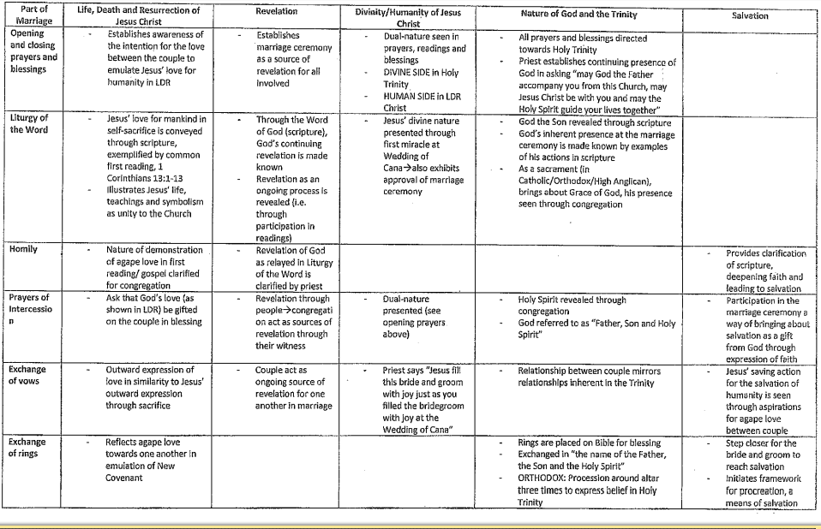
Marriage Ceremony (Principal Beliefs)

Slide 20
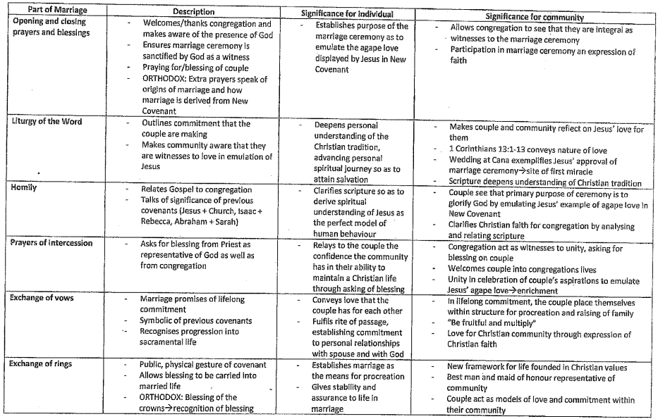
Marriage Ceremony (Significance)

